Slide 1
Stress, Growth, and Child Development
Chapter 6

Slide 2

If you are a young person and are chronically stressed, you’re not going to grow as fast.
What are some of the mechanisms underlying this?
  Elevated levels of glucocorticoids
  Elevated activation of the sympathetic nervous system
  Decreased secretion of growth hormone

Slide 3
More mechanisms
Cardiovascular stress-response
  Blood pressure goes up
    Energy to large muscle groups
    Decrease blood to digestive tract

Slide 4
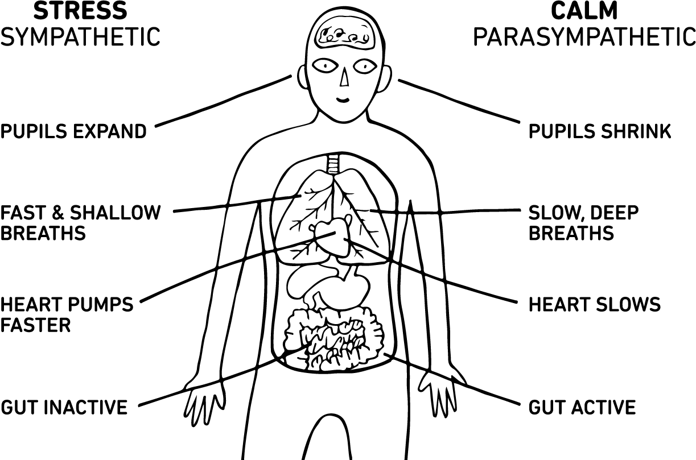
Cardiovascular
Stress-Response
What happens to blood delivery during stress-response?

Slide 5
Stress Dwarfism
The disease of stressed kids.

Slide 6
Stress dwarfism
Kids that are so stressed that they stop growing entirely
No obvious disease
No malnutrition
No parasites
No growth hormone in the bloodstream
Administer synthetic growth hormone – no effect

Slide 7
Stress dwarfism
What is the cause?
  Some appalling psychological stressor
Here’s the good news…
  Put the child in a different setting…what happens?

Slide 8
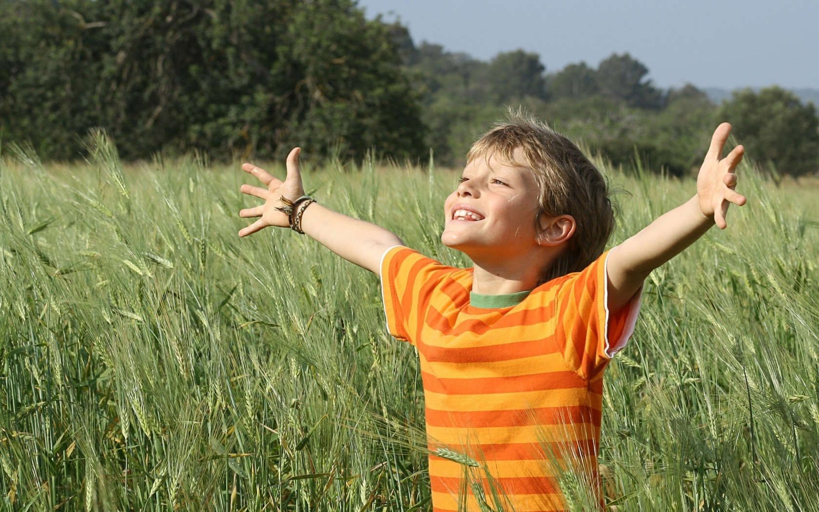

Change the environment and kids can recover!

Slide 9
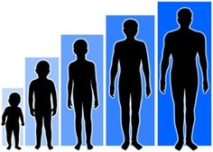
What does growth hormone do?
In children…
  Makes kids grow
In adults…
  Helps remodel bones
During stress what happens to growth hormone?

Slide 10

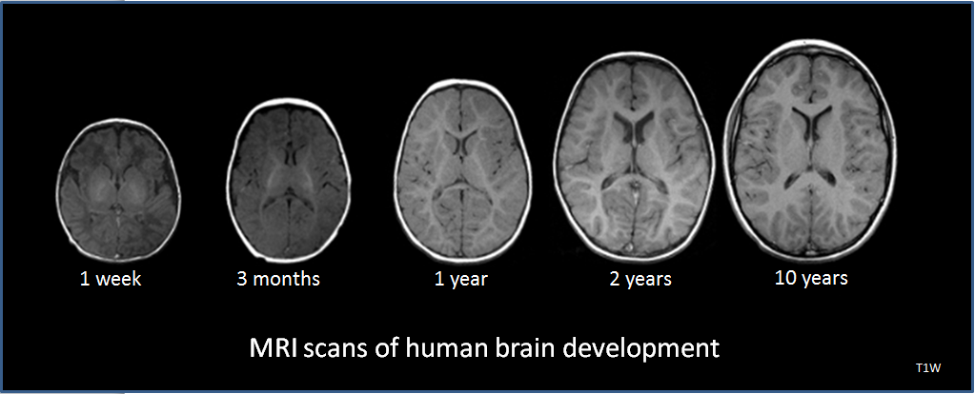
QUESTIons
Is stress dwarfism as rare as most clinicians think?
What are the effects of stress early in life on the developing brain?

